Slide 1
Operation-Analytics-and-Investigating-Metric-Spike
Operation Analytics is the analysis done for the complete end to end operations of a company. With the help of this, the company then finds the areas on which it must improve upon. You work closely with the ops team, support team, marketing team, etc and help them derive insights out of the data they collect.
Being one of the most important parts of a company, this kind of analysis is further used to predict the overall growth or decline of a company’s fortune. It means better automation, better understanding between cross-functional teams, and more effective workflows.
Investigating metric spike is also an important part of operation analytics as being a Data Analyst you must be able to understand or make other teams understand questions like- Why is there a dip in daily engagement? Why have sales taken a dip? Etc. Questions like these must be answered daily and for that its very important to investigate metric spike.

Slide 2
Description
APPROACH:
I gather the information from the description provided i.e., which tasks I need to complete.
Using MYSQL Workbench I created new files and I started writing my queries to achieve the result.
Later I executed the Queries and if there are any errors in the code, I modified the code and fixed the code without any errors.
I Revised the code once after completion of execution.
Finally, I attached my code to the file.
TECH STACK USED:-
❖ SQL ❖ Development tool – MYSQL Workbench version 8.0.30. The main purpose of using MySQL workbench is that it provides the console to simply editable and administer the MYSQL environments and to gain better results and insights of the data. It provides data modeling, SQL development and connecting servers and is the best tool to design, generate and manage the databases.

Slide 3
Case Study 1 (Job Data)
Below is the structure of the table with the definition of each column that you must work on:
Table-1: job_data job_id: unique identifier of jobs
actor_id: unique identifier of actor
event: decision/skip/transfer
language: language of the content
time_spent: time spent to review the job in seconds
org: organization of the actor
ds: date in the yyyy/mm/dd format. It is stored in the form of text and we use presto to run. no need for date function

Slide 4
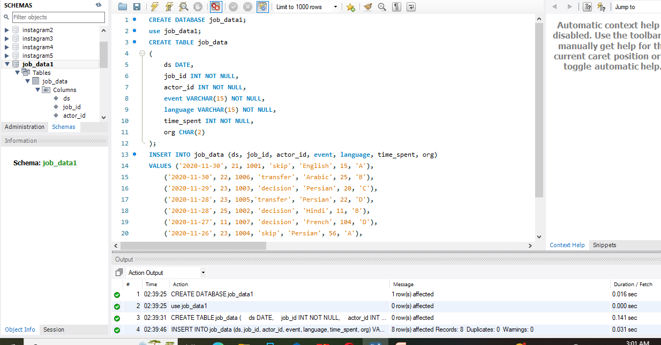

Slide 5
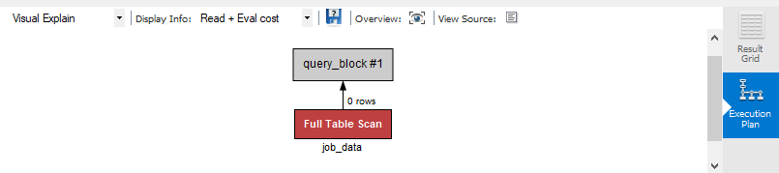
Execution Plan

Slide 6
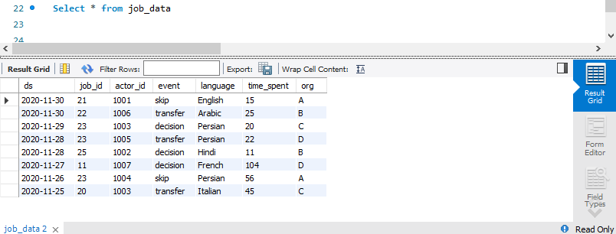
Result Grid

Slide 7
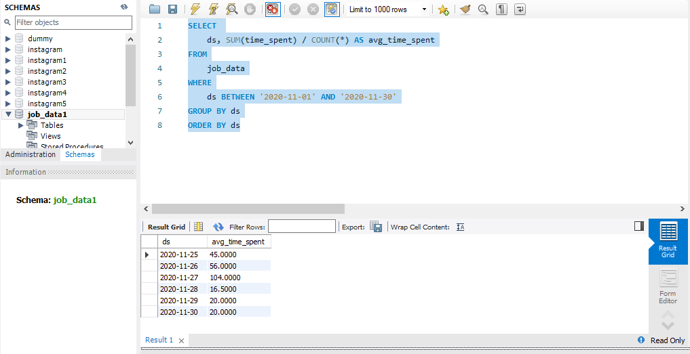
Task: Calculate the number of jobs reviewed per hour per day for November 2020?

Slide 8
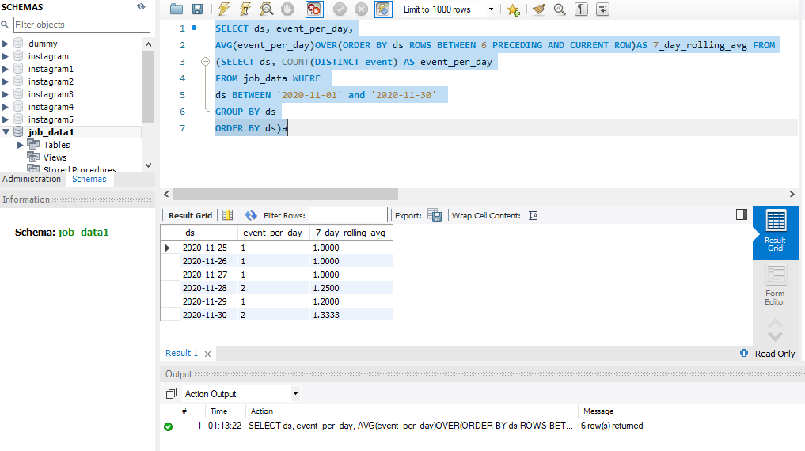
Task: Let’s say the above metric is called throughput. Calculate 7 day rolling average of throughput? For throughput, do you prefer daily metric or 7-day rolling and why?

Slide 9
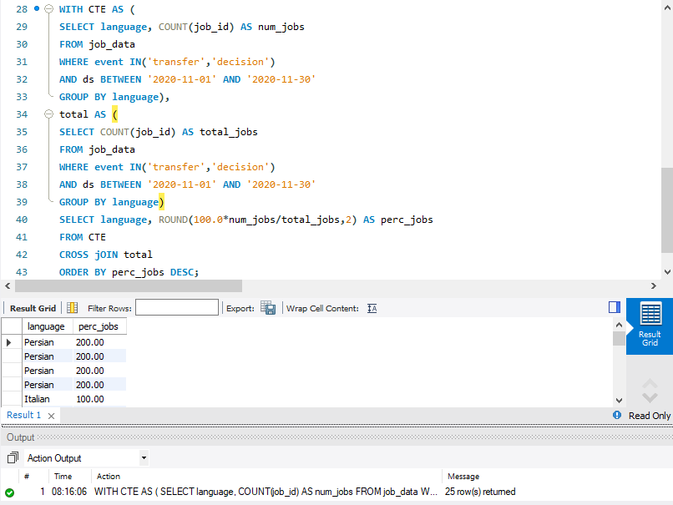
Task: Calculate the percentage share of each language in the last 30 days?

Slide 10
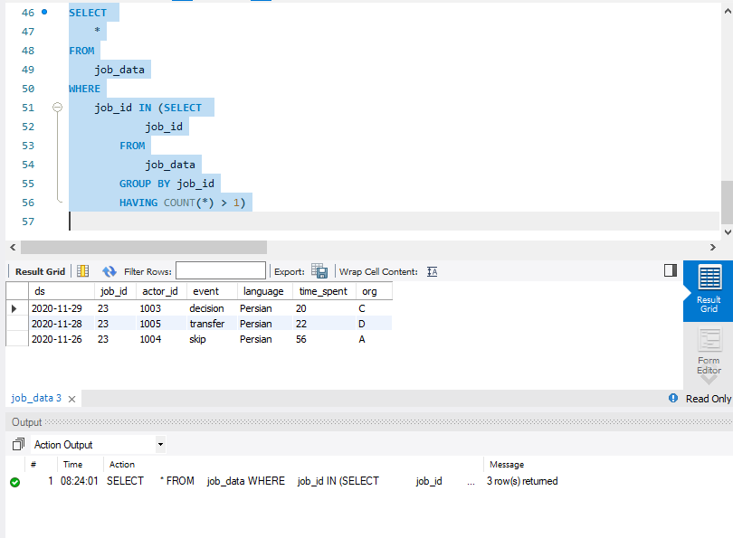
Task: Let’s say you see some duplicate rows in the data. How will you display duplicates from the table?

Slide 11
Case Study 2 (Investigating metric spike)
The structure of the table with the definition of each column that you must work on is present in the project image
Table-1: users This table includes one row per user, with descriptive information about that user’s account.
Table-2: events This table includes one row per event, where an event is an action that a user has taken. These events include login events, messaging events, search events, events logged as users progress through a signup funnel, events around received emails.
Table-3: email_events This table contains events specific to the sending of emails. It is similar in structure to the events table above

Slide 12
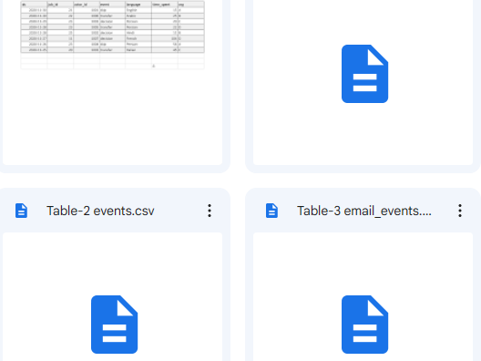
Case Study2-Dataset
Created Table and inserted values by IMPORT WIZARD in MYSQL

Slide 13
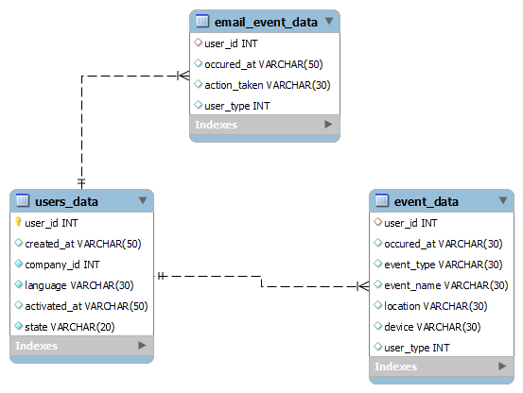

Slide 14
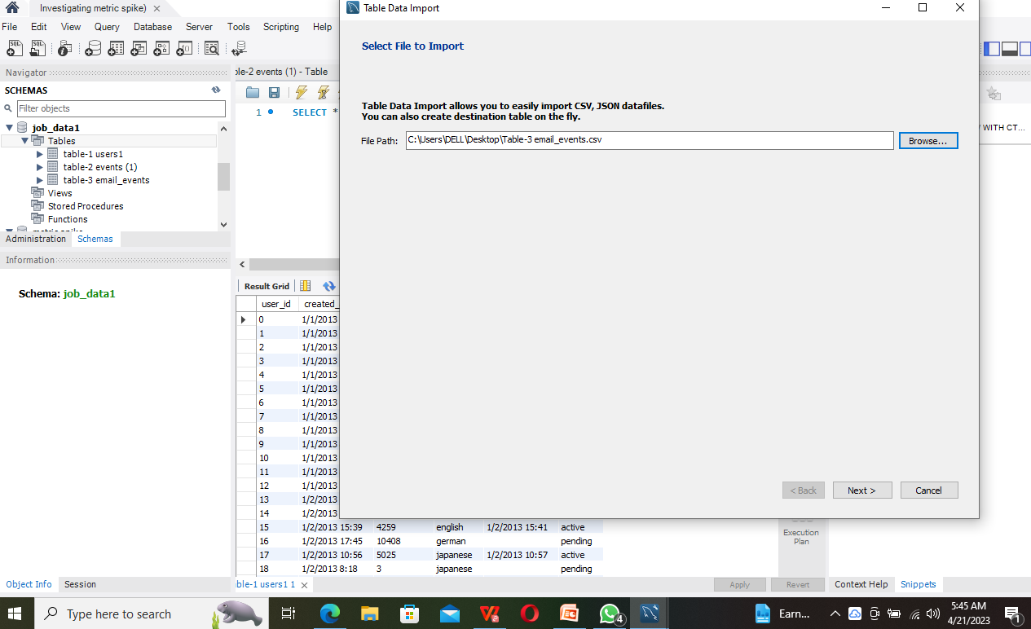

Slide 15
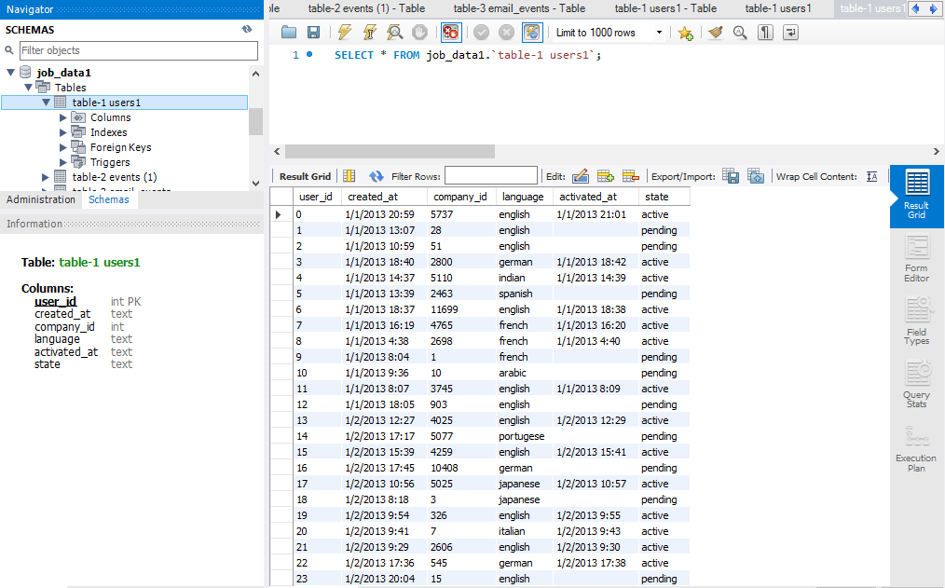
Table-1: users

Slide 16
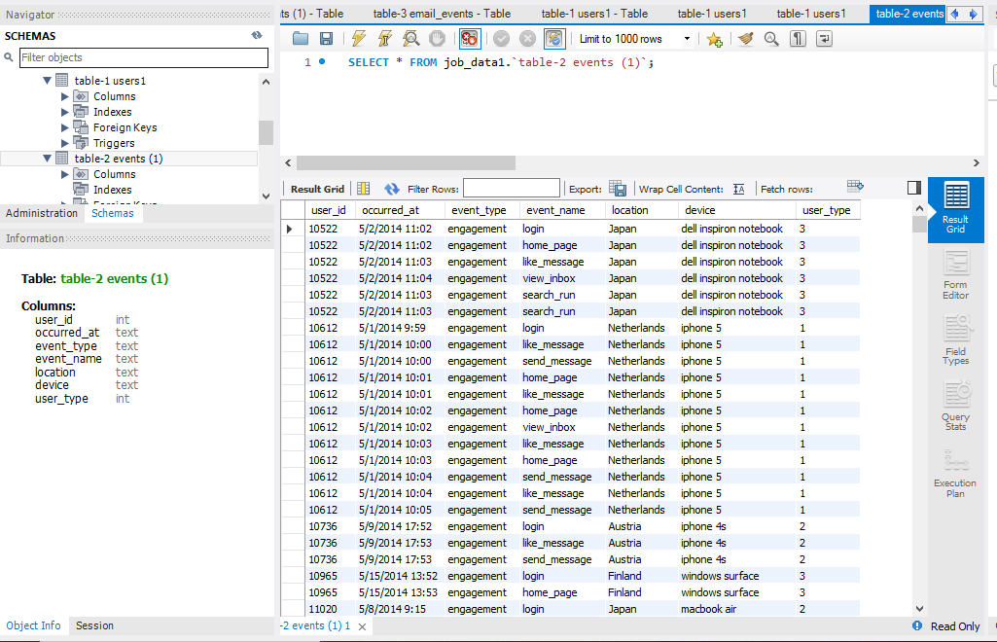
Table-2: events

Slide 17
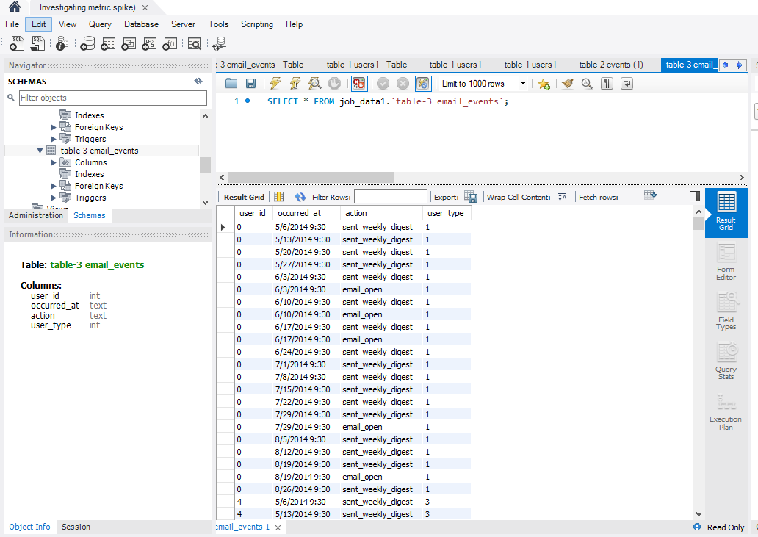
Table-3: email_events

Slide 18
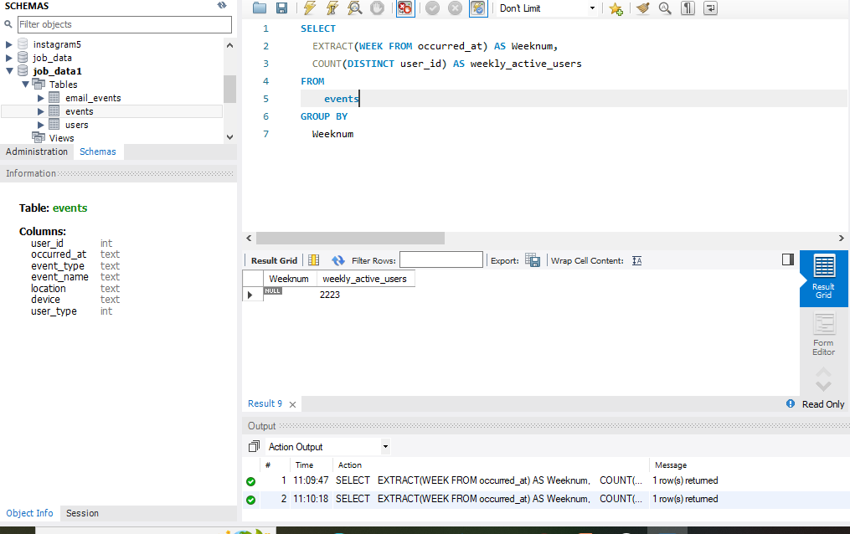
Task: Calculate the weekly user engagement?

Slide 19
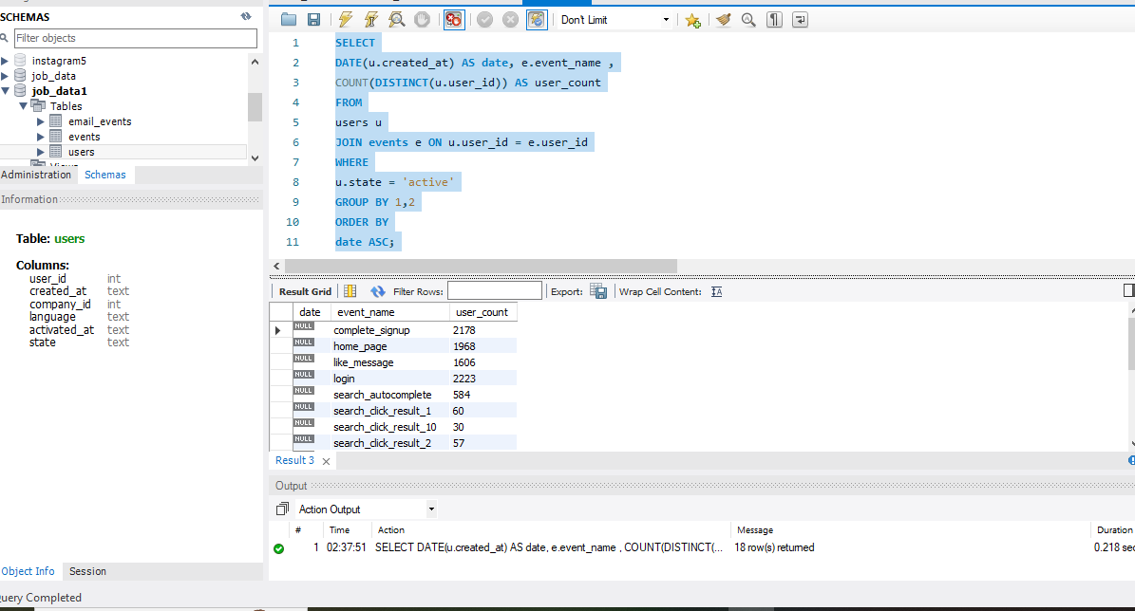
Task: Calculate the user growth for product?

Slide 20
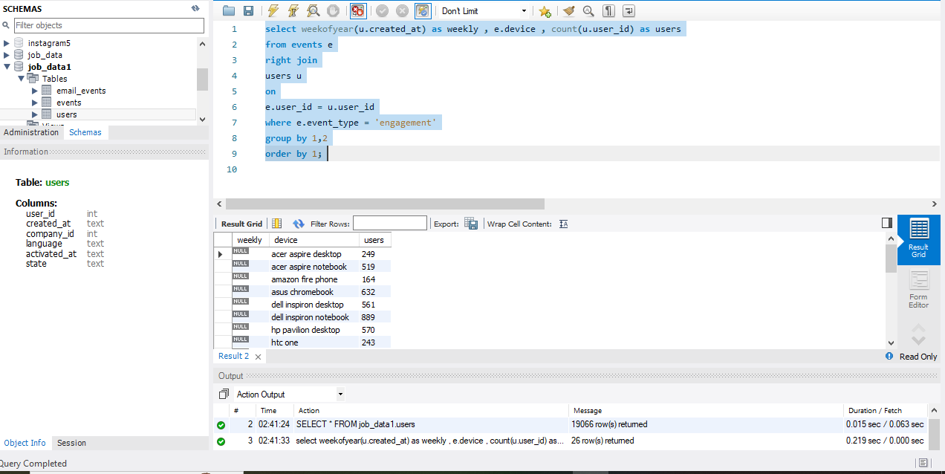
Task: Calculate the weekly engagement per device?

Slide 21
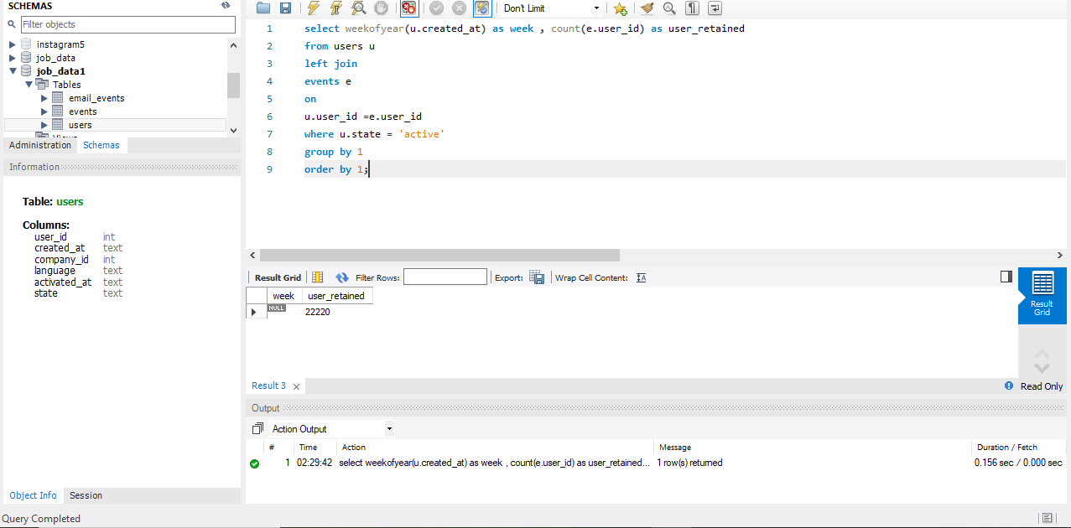
Task: Calculate the weekly retention of users-sign up cohort?

Slide 22
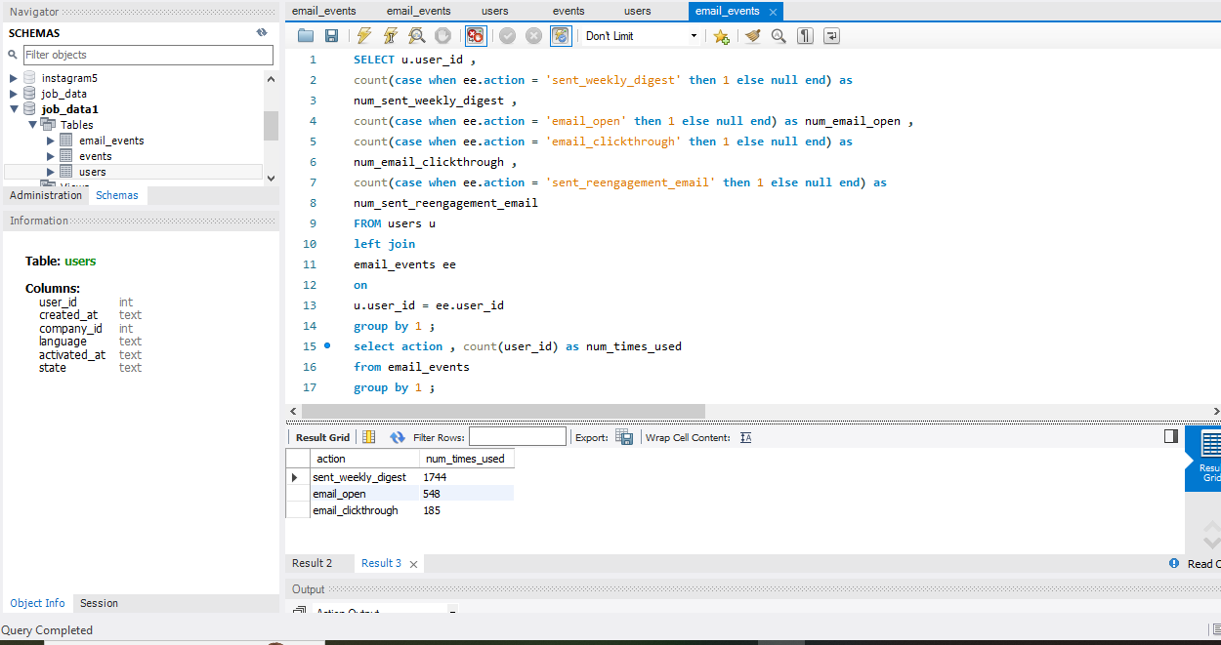
Task: Calculate the email engagement metrics?

Slide 23
Result-Learning
Demonstrated strong problem-solving skills, identifying the most appropriate approach to analyzing data based on the questions being asked
Conducted data analysis to provide insights to different departments by filtering, aggregating, and joining data as necessary, including investigating metric spikes to understand dips in daily engagement

Slide 24
THANK YOU

